Slide 1
Budget Buster
Team 11
Lee Miller
Jared Berkowitz

Slide 2
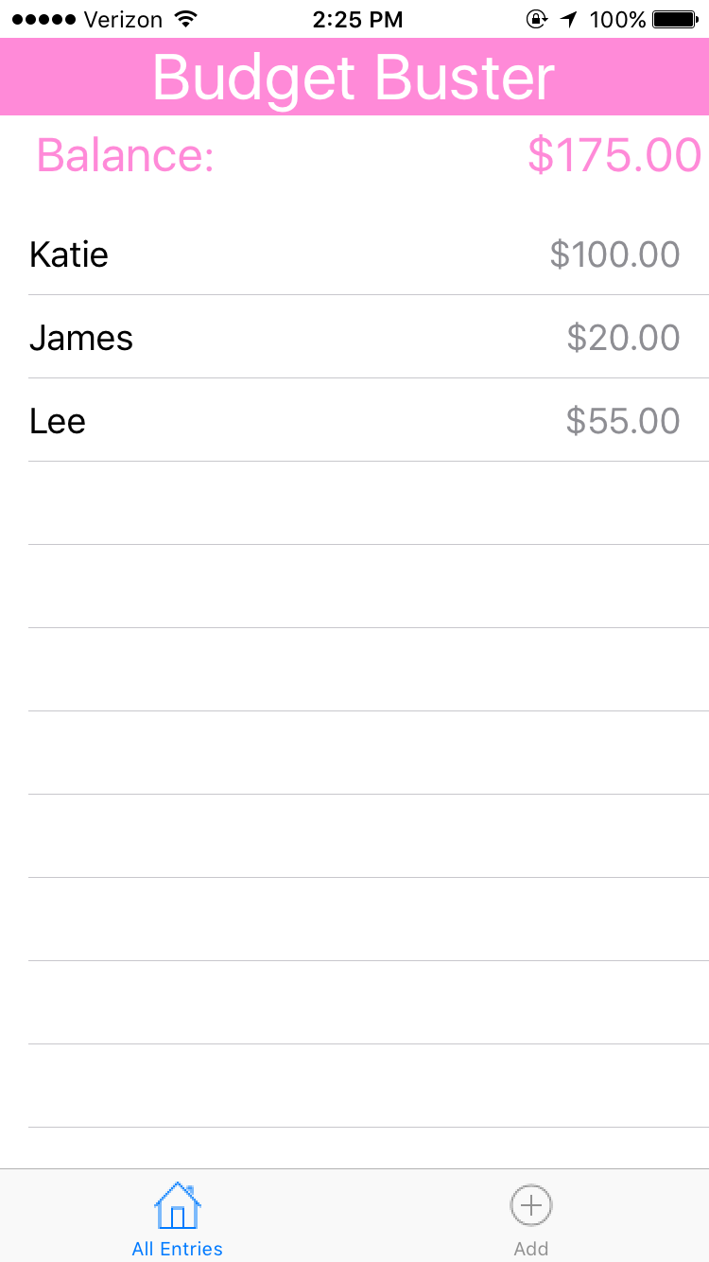
Budget Buster
Budget Buster is a budgeting app to help keep track of bills, payments
to and from friends, and income.
The app provides an interface for the user to keep track
of all of their payments in one place.
The app shows you your balance to help with budgeting,
and you can add, delete, and keep track of your
payments all in the same place.

Slide 3
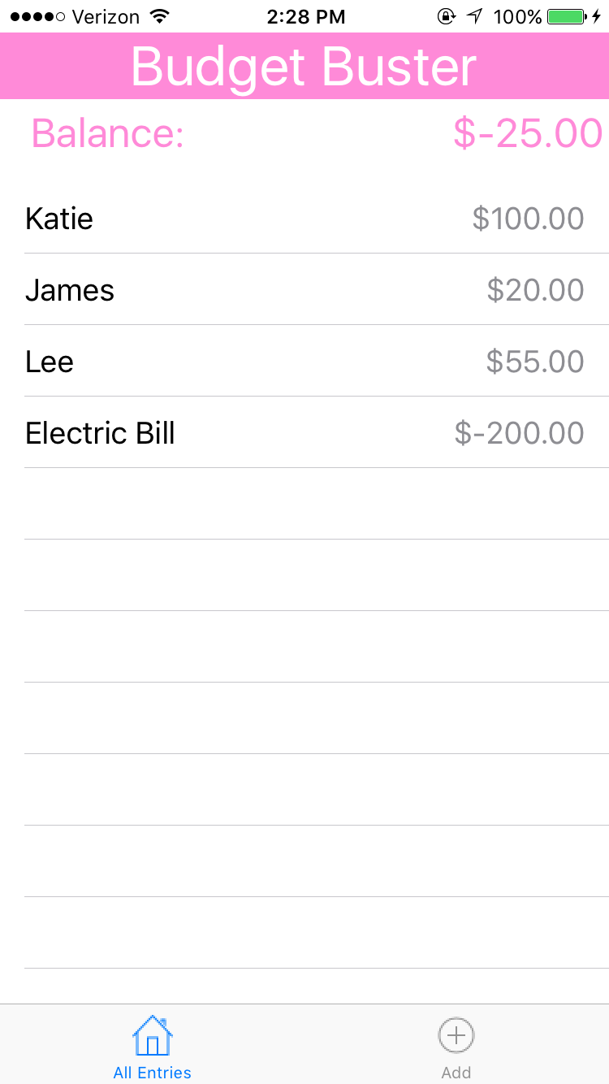
Keeping Track of Payments
The All Entries tab is where you will be keeping track of your payments.
From the All Entries tab, you can keep track of all
of your payments, see your total expenses
and delete expired or unnecessary entries.

Slide 4
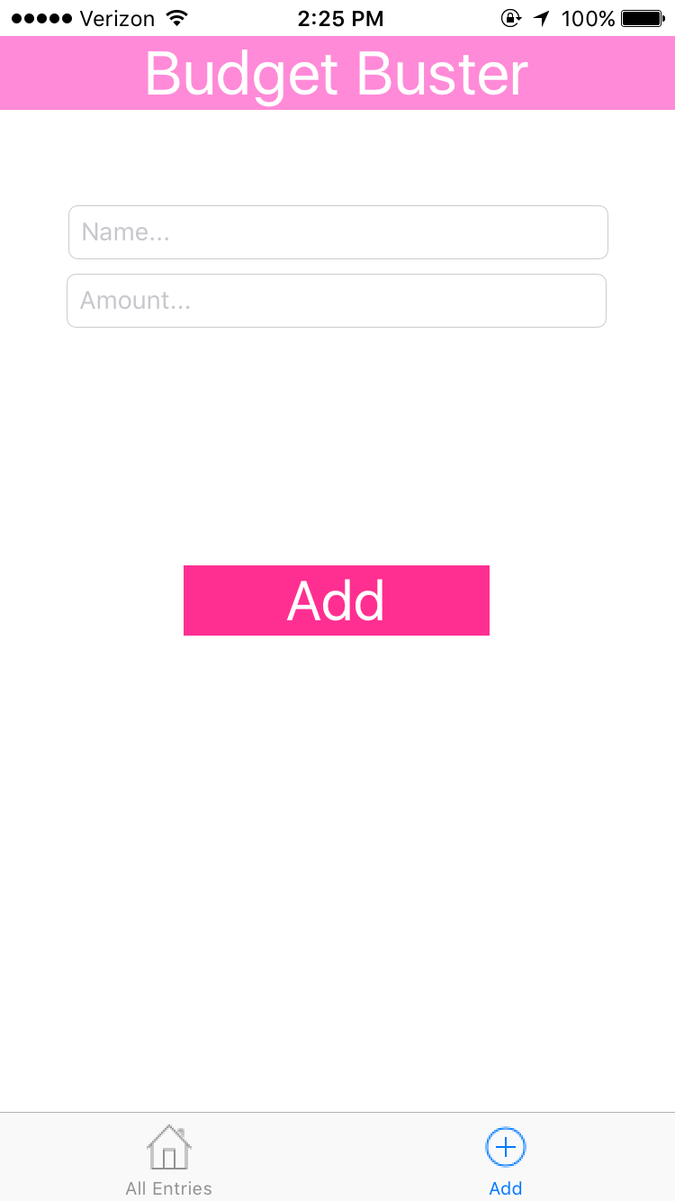
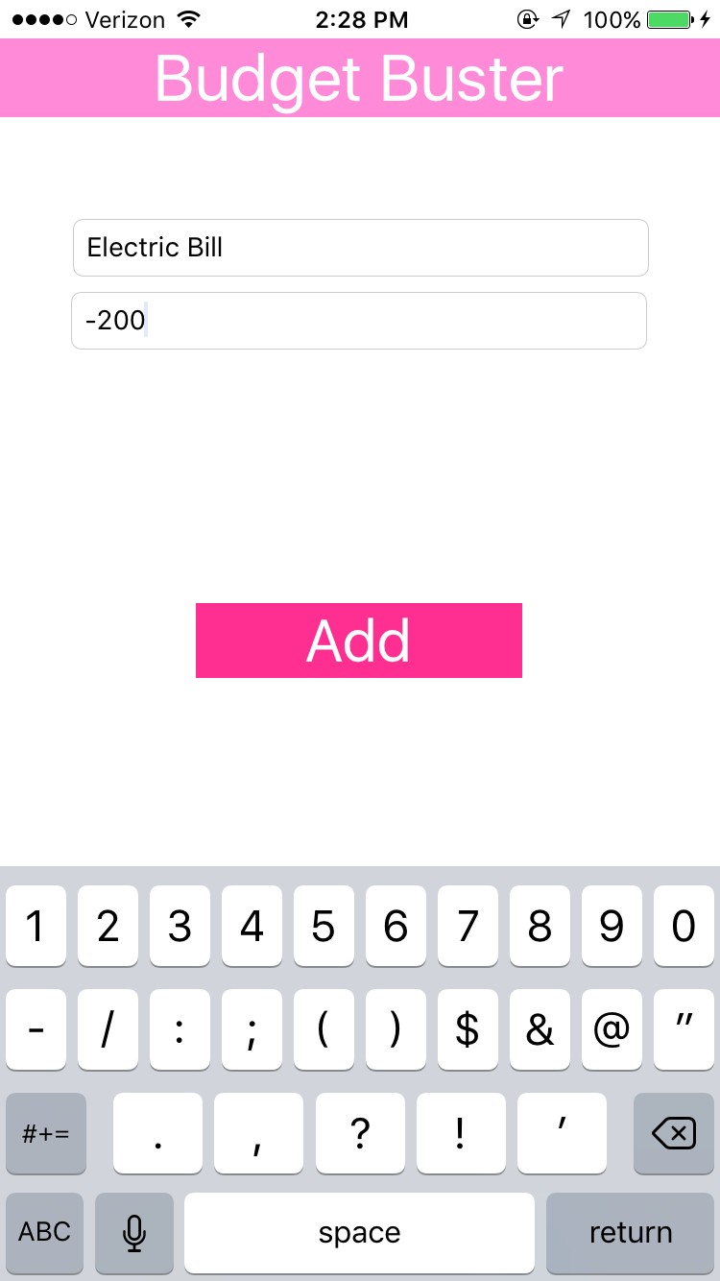
Adding Payments
Adding payments is very simple and only requires the name of the source of the
payment and the amount the payment is for.
To add an entry, you must enter the name of the payment and the amount that is due.

Slide 5
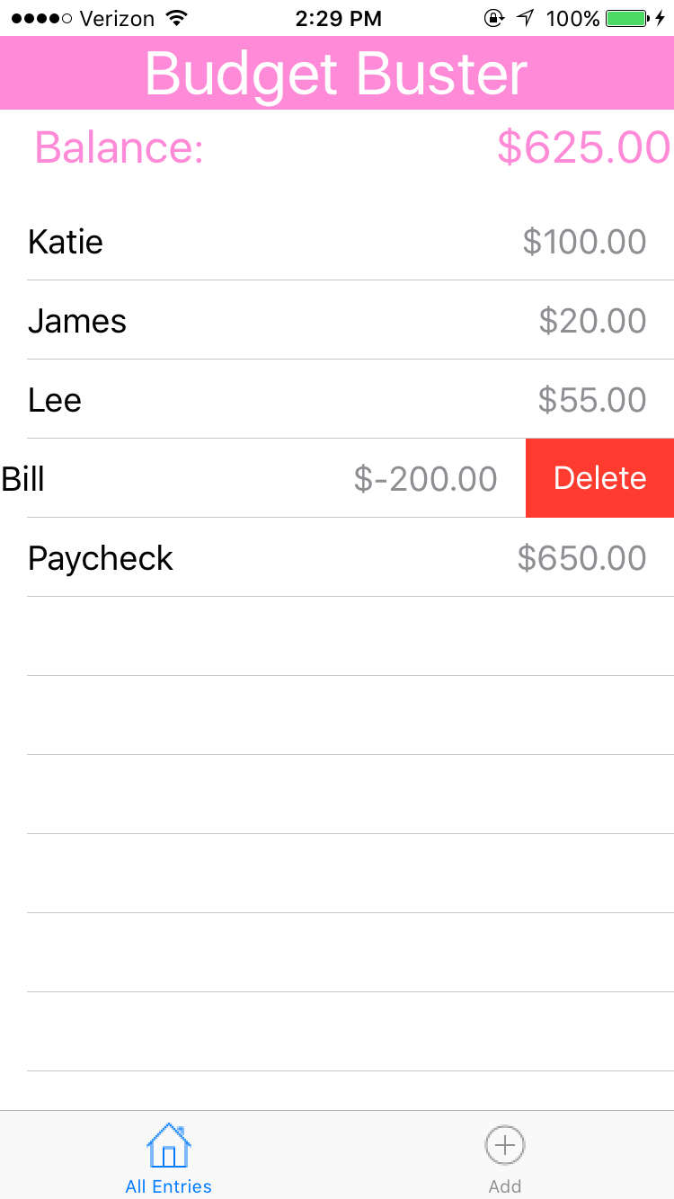
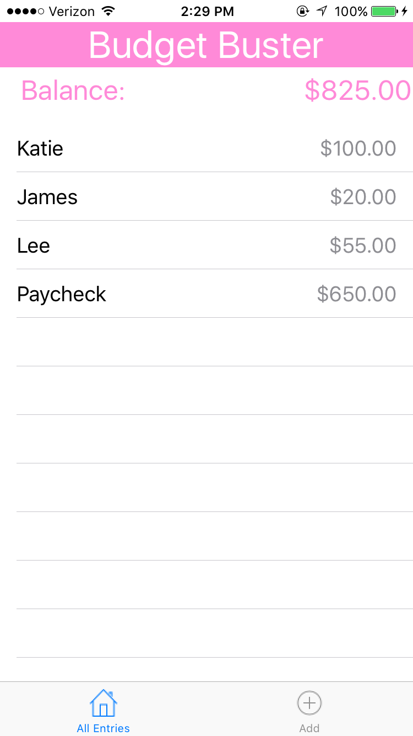
Deleting Payments
Deleting payments can be done under the All Entries tab.
Deleting a payment will adjust your balance accordingly.

